Slide 1


Core Monitoring
#sqlinthecity
Steve Jones
SQL Server Central, Red Gate Software

Slide 2
Goals
Understand the value of monitoring
Understand what baselines are
Learn the core items to monitor for SQL Server

Slide 3
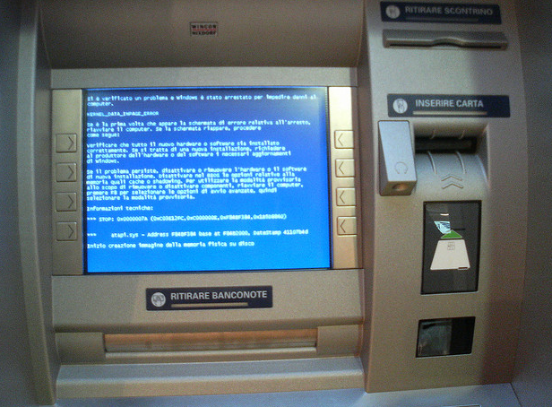
Accidents Happen
Notes:
Accidents happen. Systems will fail. When something happens, you want to know about it as soon as possible.

Slide 4

Workloads Grow
Notes:
Workloads can grow. We’ve seen some famous failures of large systems from Microsoft, Amazon. Facebook, and Twitter. In some cases you can’t do anything, but in many you can see workloads growing and take proactive actions.

Slide 5

Systems Evolve
Notes:
Not only can we have problems, but we can just have change. The way our systems work as we enhance and patch them, the way our applications are used will change as our organizations change. We want to know when those changes are occurring so we can provide the services we need to for our customers.
http://www.flickr.com/photos/48220147@N07/8068255361/in/photolist-dhXVe4-e8uDwc-7ThDci-88a1nS-7FMFjC-8nhbin-dorMZv-8xpk4h-7JKe33-7JFibR-8SS7EJ-7CuWcv-bNGqFK-8xpm3N-8xpkGL-8xpk9Y-axoysW-atrwpR-8xpmbL-auSBrK-cR4cbE-bUQC5N-e5j8W2-8wBuqT-7C8pCw-93wUnz-dwCCjH-8JxGh2-844Ku9-7Ydxrz-dJBMGb-8m1BFw-8EkXX3-7zGqZC-8HWffw-a84fQD-a878qf-a84g2p-a878mb-a84g62-a878C9-7y4z2D-8KVGNd-89cnvX-9FJMYs-9FFTu4-arRMAa-aHPXPe

Slide 6
What is Monitoring?
Awareness of the state of a system
Tracking state across time
Alerts for changes
  Does not mean critical alerts/pages
For SQL Server this includes
  Tracking key hardware metrics (CPU, memory, I/O)
  Tracking instance/database metrics (transactions)
  Business metrics
Notes:
Monitoring is an awareness of your system. Even if it’s not you, at least some system is tracking how your database is functioning.
Monitoring includes tracking this information across time, not just at spot values.
Monitoring includes some response, in the form of alerts. These need not be urgent pages people respond to, but they can be flags that get attention the next day, or sometime this week.

Slide 7

What’s Normal?
Notes:
Is a query that takes 48 minutes to run, slow? We have no way to know. If this query is supposed to run in 5 minutes, yes. If it normally takes 60 minutes, no. Einstein in 1905 studied the speed of light and was trying to explain its speed. Unlike physical objects, the speed of light doesn’t vary if you are moving towards, away, or across its path. Speed is a function of distance and time. Until this point, most physicists, and people in general, assumed that time was an absolute. It was a point of reference we all could use as a basis for measurement. Einstein postulated that time was in fact relative, and it might vary depending on the observer.
The same thing applies to our systems. We can’t necessarily look at any measurements and declare them good or bad. For example, PLE of 300. This isn’t necessarily a good measurement. We can only measure our systems in relation to some known values.

Slide 8
Baselines
Using monitoring data over time
Understanding what “normal” is
Trending
Extrapolation
Notes:
Baselines are an extension of monitoring, in what you use the monitoring data over time to gain an understanding of what the normal state of the system is. This can be something you use proactively, or something you check when there is suspicion that a system is not acting normal.
There are two proactive uses for baseline information. The first is trending, and understanding how your system is changing over time (growing or shrinking) along some axis of measurement.
Extrapolation is using the data to predict specific future behaviors, such as the amount of disk space you will need at some point in the future.

Slide 9
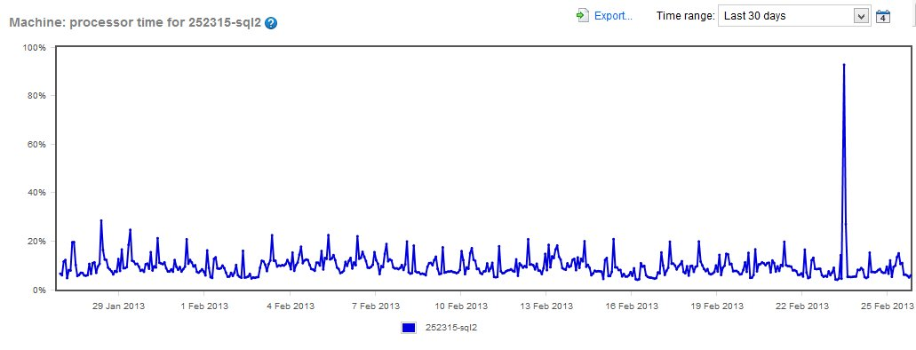
Baselines
Notes:
Here is an example of the SSC database. We have a two node cluster, which was running as active/active earlier this year. As you can see, we were barely using the hardware, at 20%. I believe this was the Simple Talk node. As a DBA, we like this. 20%, lots of headroom. As a CTO/CFO, this is a waste of hardware.
At some point, we failed over. This was a short period of time, but you can see a spike here. We failed back.
I wish that I had captured the SSC node at this time period since it would have been interesting to see the load on the other node. If it were also at 20%, then we’d know we had a hardware mismatch here. That would be useful information. We may or may not have done something, but it might let us know as the first node load increases, we need to consider increasing this hardware as well. Or we should investigate if we have other tenants on this hardware (it’s virtual) that might be causing issues.

Slide 10
Core Items to Monitor
Lots of choices
  Windows performance counters
  SQL Server performance counters
  Hypervisor counters
  SQL Server management metrics
  Trace/Extended Events
Lots of lists available
  Can be version specific
Notes:
There are lots of choices in terms of which items to monitor on your servers. There are Windows and SQL Server performance based counters. These are items that measure how well the system is performing, like CU%, transactions/sec, and more. There could be hypervisor counters that you need to monitor as well if you are in a virtual environment. If you are unaware of these counters, you might mis-diagnose or mis-understand how your system is performing. There are also SQL Server management counters, things like the time since the last DBCC or backup. Those don’t affect performance, but they are core monitoring items.
Beware that many of the lists available are version specific, and advice may change over time. If you are looking at an article/blog/video/etc, please ensure that it corresponds to your version. New information and features sometimes change the monitoring you need to set up.

Slide 11
Core Items to Monitor
Your list of metrics will be unique to your environment.
Notes:
There are lots of choices in terms of which items to monitor on your servers. There are Windows and SQL Server performance based counters. These are items that measure how well the system is performing, like CU%, transactions/sec, and more. There could be hypervisor counters that you need to monitor as well if you are in a virtual environment. If you are unaware of these counters, you might mis-diagnose or mis-understand how your system is performing. There are also SQL Server management counters, things like the time since the last DBCC or backup. Those don’t affect performance, but they are core monitoring items.
Beware that many of the lists available are version specific, and advice may change over time. If you are looking at an article/blog/video/etc, please ensure that it corresponds to your version. New information and features sometimes change the monitoring you need to set up.

Slide 12
Core Items to Monitor
Performance Counters
  Memory – Available MBytes
  Paging File – % Usage
  Physical Disk – Avg. Disk sec/Read
  Physical Disk – Avg. Disk sec/Write
  Physical Disk – Disk Reads/sec
  Physical Disk – Disk Writes/sec
  Processor – % Processor Time
  SQLServer: Buffer Manager – Page life expectancy
  SQLServer: General Statistics – User Connections
  SQLServer: Memory Manager – Memory Grants Pending
  SQLServer: SQL Statistics – Batch Requests/sec
  SQLServer: SQL Statistics – Compilations/sec
  SQLServer: SQL Statistics – Recompilations/sec
  System – Processor Queue Length
  From: SQL Server Perfmon (Performance Monitor) Best Practices
Notes:
This is a list of performance metrics from Brent Ozar PLF. It’s a good base list. You may need other items, or want to capture other information, but this is a good base list. If you find there are other hardware items that impact your system, you may want to add them, and document the list for others.

Slide 13
Core Items to Monitor
Hypervisor Counters
  CPU usage
  Memory usage (especially balloon counters and swapping)
  Disk I/O
  Check with your hypervisor administrator/vendor/consultants
Notes:
Here are counters that help ensure you are checking things that impact availability and reliability.

Slide 14
Core Items to Monitor
Administrative Items
  Machine is running (Windows and SQL Server levels)
  Backup time
  Log shipping delay
  Mirroring delay
  Cluster/AG failover
  Job Failure/Duration
  High Severity Errors
Notes:
Here are counters that help ensure you are checking things that impact availability and reliability.
The first one might be obvious, but you never know when there are systems that go down, which are not in use.
Peoplesoft story, end-of-quarter/EOY system that was down on the 14th of the month. Not checked until the 24th and we were unaware this was down until we were called.
These are items that affect the performance and reliability of your system in real time.

Slide 15

Demo
Performance Monitoring
Notes:
Demo 1 – Show perf counters in SQL Server
Demo 2 – Correlate data from counters.
- run perfmon
- new user defined set, manually
- get perf mon data
- Add two counters (CPU, disk IO)
- defaults, store in local disk, start.
- run profiler, tuning template, add start/end times, filter by ADW
- run sql code
- stop trace, save file
- stop collection set.
- reopen trace, import perf data
- show performance monitoring with SQL Monitor

Slide 16
Monitoring is not just for performance
Notes:
Monitoring is for more than just performance. Other things come into play.

Slide 17
Beyond Performance
Administrative tasks need to be monitored
  DBCC
  Fragmentation
  Backups
  Job Duration
  Disk Space
  Long running queries
  Monitoring Down?

Slide 18
Beyond Performance
Business processes should be monitored
  How many orders are you receiving?
  Are ETL loads completing?
  Inventory status
Development
  Tracking Changes
  CI metrics
  Open ticket times
Notes:
In addition to the technical stuff you monitor for performance and administrative tasks, you should consider including various business metrics. These may be sent to business people instead of technical people. You might use your monitoring framework to do this, in addition to the technical stuff. These items, which might be considered meta data about the operation of your system, could be valuable for helping your business work more efficiently.
In terms of development, you might use this type of framework to help enforce or teach practices, or even understand how efficient your development staff works. You could track changes, especially unauthorized ones. You might use this to track builds in a CI process, or even the length of time tickets are open if your ticketing system runs on SQL Server.

Slide 19
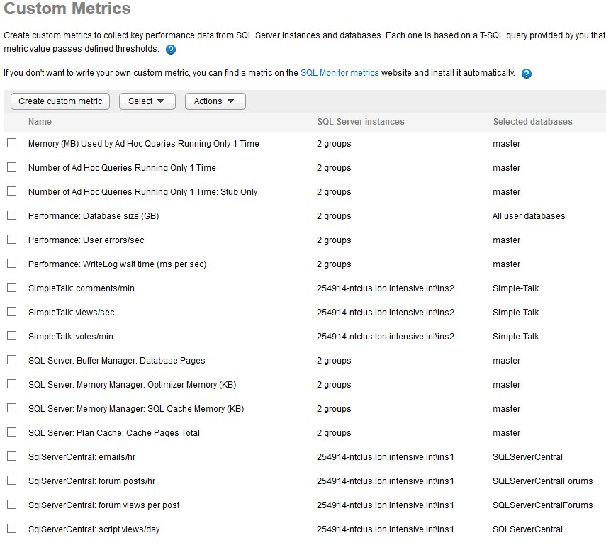
http://monitor.red-gate.com
Notes:
Here are a number of custom items we’ve added to our database servers. Note that we track metrics from Simple Talk that give us an idea of how much engagement and activity is occurring on the system at a given time. We track some of these items in the application, but we don’t often see the distribution or rate at which they occur. We can also monitor these items and set alerts that notify us if the rates are too low, a sign that things have gone wrong. We do the same thing at SQLServerCentral.

Slide 20
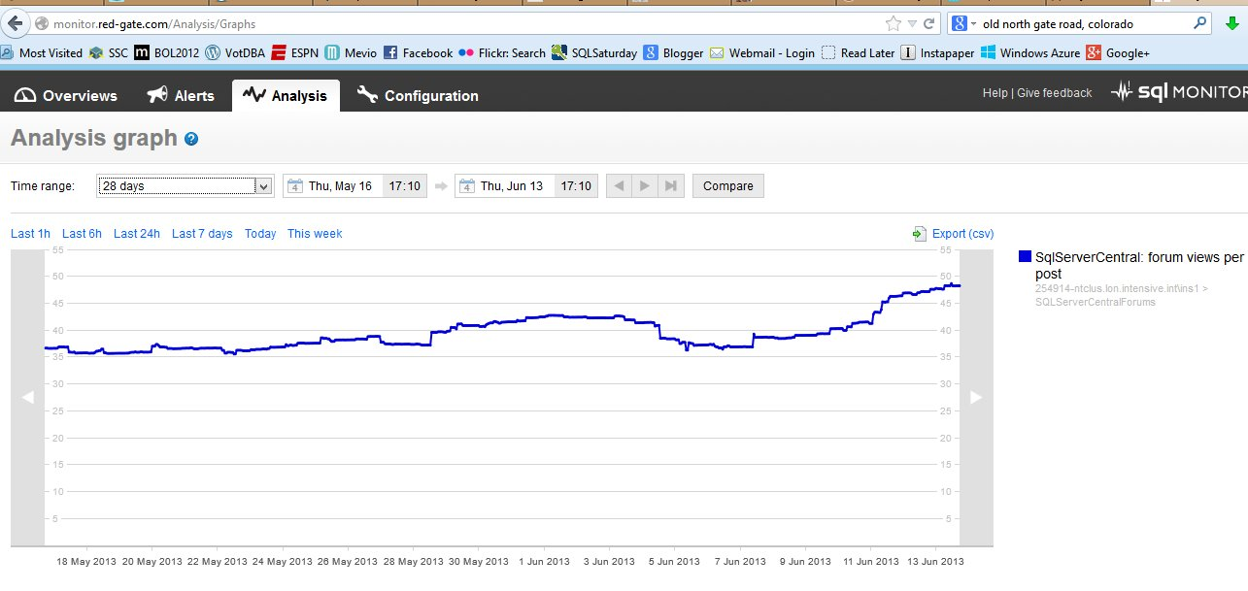
Business Metrics

Slide 21
Demo
Tracking administrative and business metrics
Notes:
Demo 1 – administrative tracking, look for missing backups, dbccs, severity, mirroring send queue metric
Demo 2 – Setup object change tracking in SQL Monitor

Slide 22
Homework
Make sure you have a baseline of all instances
  Have a list of your metrics
  Don’t over monitor
Set a reminder to periodically review “normal”
  Monthly meeting
  store baselines reports for reference
Add counters/metrics as necessary to ensure you understand your environment
Notes:
Items that the attendees should look at next week at work. Get baselines, get a schedule.

Slide 23
Goals
Understand the value of monitoring
Understand what baselines are
Learn the core items to monitor for SQL Server

Slide 24

The End
Questions?
www.sqlservercentral.com/forums
Sponsored by Red Gate Software and the SQL DBA Bundle
Speak to the Red Gate team during the breaks for more info about the tools in the SQL DBA Bundle
Backup and recovery
Troubleshooting
Productivity
Performance monitoring
Change management
Storage and capacity planning
Documentation

Slide 25
Learn More
http://www.sqlservercentral.com
http://www.simple-talk.com
http://www.red-gate.com/products/dba/dba-bundle/entrypage/hard-earned-lessons
http://www.scarydba.com/tag/query-tuning/
http://voiceofthedba.wordpress.com/tag/administration/

Slide 26
References
Monitoring (Wikipedia) - http://en.wikipedia.org/wiki/Monitoring
Monitoring SQL Server - http://msdn.microsoft.com/en-us/library/ee377023(v=bts.10).aspx
Performance Monitoring and Tuning Tools - http://msdn.microsoft.com/en-us/library/ms179428.aspx
SQL Monitor from Red Gate - http://www.red-gate.com/products/dba/sql-monitor/
Trending - http://www.thefreedictionary.com/trending
Extrapolation - http://en.wikipedia.org/wiki/Extrapolation
Top 10 SQL Server Counters for Monitoring SQL Server Performance - http://www.databasejournal.com/features/mssql/article.php/3932406/Top-10-SQL-Server-Counters-for-Monitoring-SQL-Server-Performance.htm
Correlating SQL Server Profiler with Performance Monitor - https://www.simple-talk.com/sql/database-administration/correlating-sql-server-profiler-with-performance-monitor/
SQL Server Perfmon (Performance Monitor) Best Practices - http://www.brentozar.com/archive/2006/12/dba-101-using-perfmon-for-sql-performance-tuning/
Correlate a Trace with Windows Performance Log Data - http://technet.microsoft.com/en-us/library/ms191152.aspx

Slide 27
Images
Blue screen of death - http://www.flickr.com/photos/_aldem/3196618156/
Twitter overload - http://www.flickr.com/photos/renaissancechambara/2584497396/
Abnormal load - http://www.flickr.com/photos/nickwebb/6189613363/
Statistics for the Utterly Confused - http://www.amazon.com/Statistics-Utterly-Confused-Series-ebook/dp/B000JMKOWI/ref=sr_1_2?ie=UTF8&qid=1360886590&sr=8-2&keywords=statistics+for+the+utterly+confused
http://www.flickr.com/photos/48220147@N07/8068255361/in/photolist-dhXVe4-e8uDwc-7ThDci-88a1nS-7FMFjC-8nhbin-dorMZv-8xpk4h-7JKe33-7JFibR-8SS7EJ-7CuWcv-bNGqFK-8xpm3N-8xpkGL-8xpk9Y-axoysW-atrwpR-8xpmbL-auSBrK-cR4cbE-bUQC5N-e5j8W2-8wBuqT-7C8pCw-93wUnz-dwCCjH-8JxGh2-844Ku9-7Ydxrz-dJBMGb-8m1BFw-8EkXX3-7zGqZC-8HWffw-a84fQD-a878qf-a84g2p-a878mb-a84g62-a878C9-7y4z2D-8KVGNd-89cnvX-9FJMYs-9FFTu4-arRMAa-aHPXPe

